Slide 1
Queue & Circular Queue

Slide 2
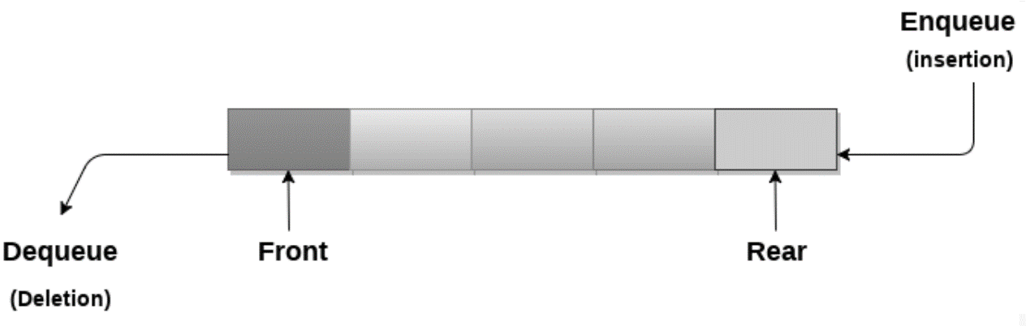
Fundamentals of Queue
Ordered list
Operation can be performed in both end.
Insert operations to be performed at one end called REAR(Enqueue).
Delete operations to be performed at another end called FRONT(Dequeue).
Queue works in First In First Out (FIFO)order.

Slide 3
APPLICATION of QUEUE
Queues are widely used as waiting lists for a single shared resource like printer, disk, CPU.
Queues are used in asynchronous transfer of data (where data is not being transferred at the same rate between two processes) for eg. pipes, file IO, sockets.
Queues are used as buffers in most of the applications like MP3 media player, CD player, etc.
Queue are used to maintain the play list in media players in order to add and remove the songs from the play-list.
Queues are used in operating systems for handling interrupts.

Slide 4
Implementation of Queue using Array

Slide 5
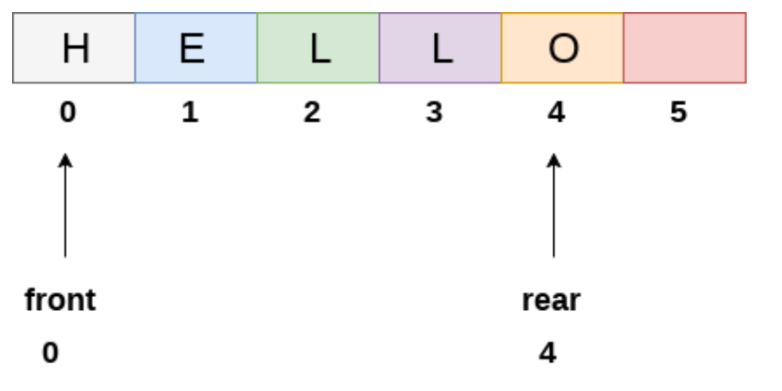
Queue in initial Position

Slide 6
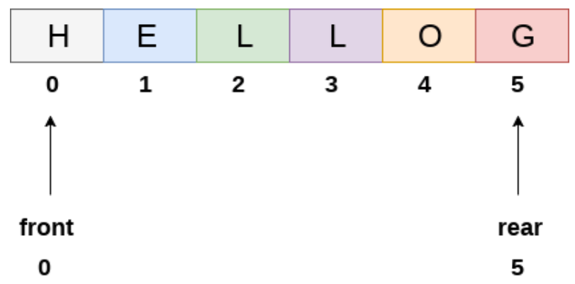
Queue after Insertion of “G”

Slide 7
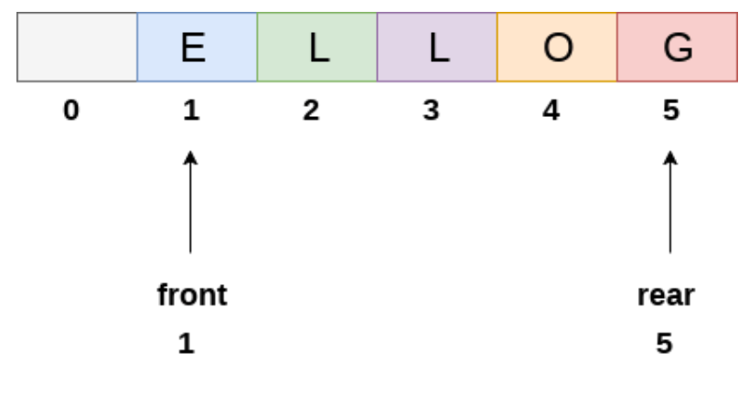
Queue after Deletion of “H”

Slide 8
Enqueue
Algorithm to insert any element in a queue
Check if the queue is already full by comparing rear to max – 1. if so, then return an overflow error.
If the item is to be inserted as the first element in the list, in that case set the value of front and rear to 0 and insert the element at the rear end.
Otherwise keep increasing the value of rear and insert each element one by one having rear as the index.

Slide 9
Dequeue
Algorithm to delete an element from the queue
If, the value of front is -1 or value of front is greater than rear ,
Then, write an underflow message and exit.
Otherwise,
keep increasing the value of front and return the item stored at the front end of the queue at each time.

Slide 10
Summary
Is full?
Is empty?
enqueue
rear++
add data
dequeue
get data
front++

Slide 11
Queue full and Empty Conditions
public static boolean isEmpty(){
if(rear==-1||front==-1)
return true;
else
return false;
}
Is empty?
public static boolean isFull(){
if(rear==MAX-1)
return true;
else
return false;
}
Is full?

Slide 12
Enqueue
public static void insert(int Q[]){
if(isFull())
System.out.println("Queue is Full!");
else{
Scanner sc=new Scanner(System.in);
System.out.println("Insert element to the queue.");
int ele=sc.nextInt();
rear++;
Q[rear]=ele;
}
if(rear==0)
front=0;
}
Is full?
rear++
add data
Is it 1st data?

Slide 13
Dequeue
Is empty?
public static void delete(int Q[]){
if(isEmpty())
System.out.println("Queue is Empty!");
else{
int ele=Q[front];
front++;
System.out.println("Element to be deleted:"+ele);
}
}
get data
front++

Slide 14
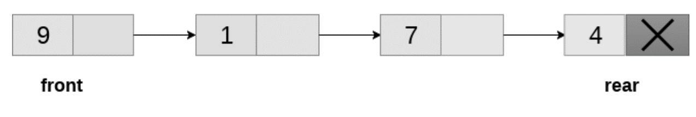
Queue using Linked List
8
5
10
55
enqueue
Insert at end
dequeue
Delete at front

Slide 15
public static Node insert (Node front){
Scanner sc=new Scanner (System.in);
Node p=new Node();
Node q=new Node();
System.out.println("Enter Info.");
p.info=sc.nextInt();
p.next=null;
if (front==null)
front=p;
else{
q=front;
while(q.next!=null){
q=q.next;
}
q.next=p;
}
return front;
}
Enqueue
Go to end and then add

Slide 16
Dequeue
public static Node delete (Node front){
if(front==null)
System.out.println("List is empty.");
else{
System.out.println("Node to be deleted. "+front.info+" at"+ front);
front=front.next;
}
return front;
}
DROPPING FIRST NODE

Slide 17
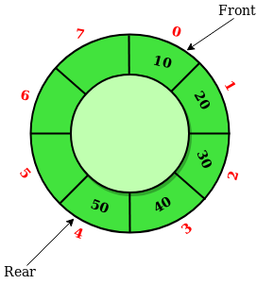
Circular Queue
Circular Queue is a linear data structure
Operations are performed based on FIFO (First In First Out) principle
last position is connected back to the first position to make a circle

Slide 18
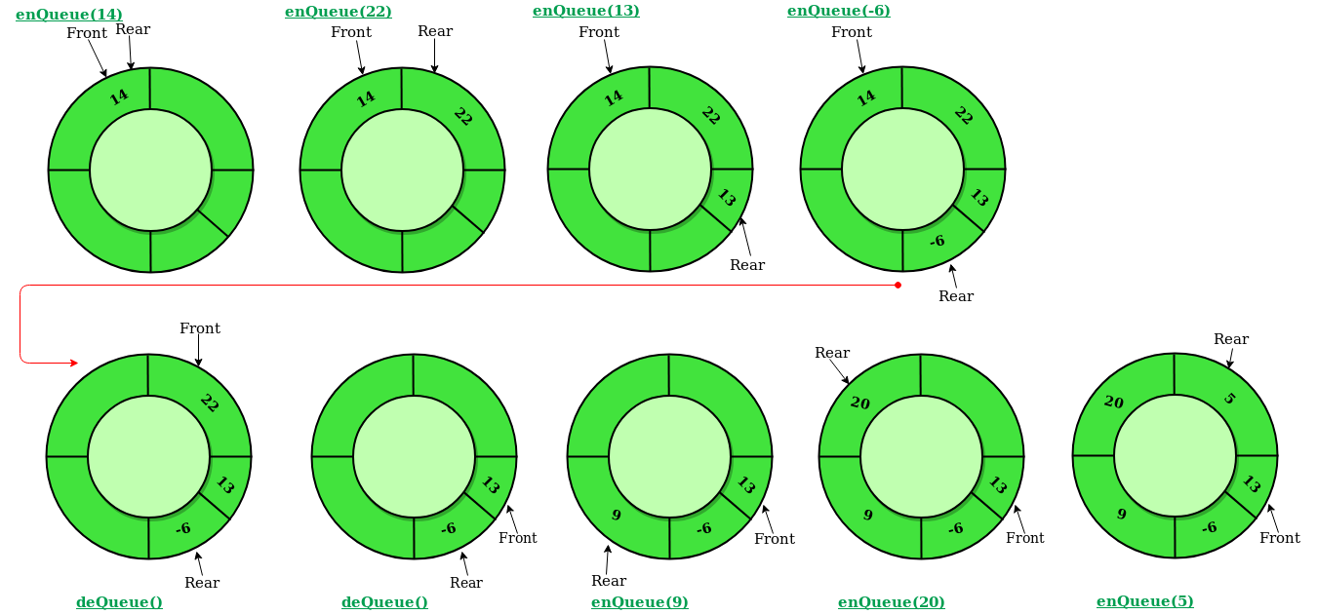
Operations on Circular Queue

Slide 19
enQueue(value) on Circular Queue
Front: Get the front item from queue.
Rear: Get the last item from queue.
enQueue(value) This function is used to insert an element into the circular queue. In a circular queue, the new element is always inserted at Rear position.
Steps:Check whether queue is Full –
((rear == SIZE-1 && front == 0) || (rear == front-1)).
If it is full then display Queue is full. If queue is not full then, check if (rear == SIZE – 1 && front != 0) if it is true then set rear=0 and insert element.

Slide 20
((rear == SIZE-1 && front == 0)
SIZE =8
front
0
7
rear
1
6
2
5
3
4

Slide 21
Last element is there
Lets delete 55, i.e dequeue
So we do, front++
0
7
front
rear
rear==front
1
55
6
Now
rear==front-1
2
5
3
4
In this case, we will insert at position 0

Slide 22
deQueue() on Circular Queue
deQueue() This function is used to delete an element from the circular queue. In a circular queue, the element is always deleted from front position.
Steps:Check whether queue is Empty means check (front==-1).
If it is empty then display Queue is empty. If queue is not empty then step 3
Check if (front==rear) if it is true then set front=rear= -1
else check if (front==size-1), if it is true then set front=0 and return the element.

Slide 23
Circular Queue using Array

Slide 24
Cqueue empty and full condition in array
Cqueue() {
front = -1;
rear = -1;
}
// Check if the queue is full
boolean isFull() {
if (front == 0 && rear == SIZE - 1) {
return true;
}
if (front == rear + 1) {
return true;
}
return false;
}
// Check if the queue is empty
boolean isEmpty() {
if (front == -1)
return true;
else
return false;
}

Slide 25
Enqueue in Cqueue using array
void enQueue(int element) {
if (isFull()) {
System.out.println("Queue is full");
} else {
if (front == -1)
front = 0;
//if(rear==SIZE-1)
//{rear=0;item[rear]=element;}
//else
//items[rear+1] = element;
rear = (rear + 1) % SIZE;
items[rear] = element;
System.out.println("Inserted " + element);
}
}
Return to first position (0), after reaching last position
Let SIZE==8. So last position is 7,
When rear is 7,
Rear+1 % SIZE i.e. (8%8)
→ 0

Slide 26
Dequeue in Cqueue using array
// Removing an element
int deQueue() {
int element;
if (isEmpty()) {
System.out.println("Queue is empty");
return (-1);
} else {
element = items[front];
if (front == rear) {
front = -1;
rear = -1;
} /* Q has only one element, so we reset the queue after deleting it. */
else {
front = (front + 1) % SIZE;
}
return (element);
}
}

Slide 27
Circular Queue using LinkedList
Similar to Queue using linked list, except
Last node points to first node (circular linked list)
Rear points to front.
rear.next=front.
Unlike previous program, lets maintain a rear pointer
We do not have to run a while loop each time, to reach the end
q=front;
while(q.next!=null){
q=q.next;
}

Slide 28
static class Queue
{
Node front, rear;
}
p is the first node to be added
add p to the end
static void enQueue(Queue q, int value)
{
Node p = new Node();
p.info = value;
if (q .front == null)
q .front = p;
else
q .rear .next = p;
q .rear = p;
q .rear .next = q .front;
}
Update the new end (rear)
rear will point to end
INSERT AT THE END OF THE CIRCULAR LINKED LIST

Slide 29
static int deQueue(Queue q)
{
if (q .front == null)
{
System.out.printf ("Queue is empty");
return Integer.MIN_VALUE;
}
// If this is the last node to be deleted
int value; // Value to be dequeued
if (q .front == q .rear)
{
value = q .front .info;
q .front = null;
q .rear = null;
}
else // There are more than one nodes
{
Node p = q .front;
value = p.info;
q .front = q .front .next;
q .rear .next= q .front;
}
return value ;
}
If the last node is being deleted
DELETE AT THE BEGINING OF THE CIRCULAR LINKED LIST

Slide 30
Thank YOU

